Slide 1

Tower Slope Update: R_function multiple trials
Parker Lewis

Slide 2
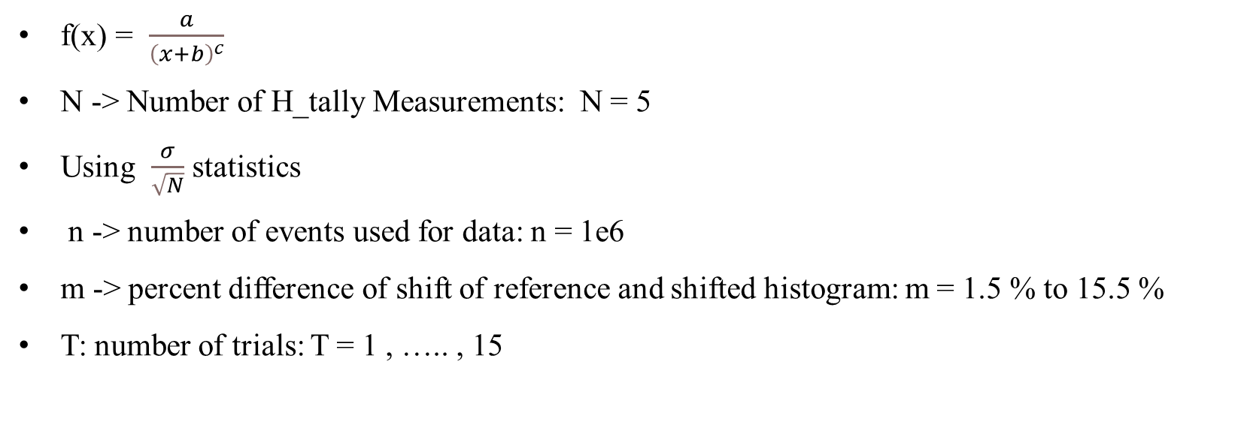
Known Info of Data Analysis
f(x) = $\frac{a}{{\left(x+b\right)}^{c}}$
N -> Number of H_tally Measurements: N = 5
Using $\frac{σ}{\sqrt{N}}$ statistics
n -> number of events used for data: n = 1e6
m -> percent difference of shift of reference and shifted histogram: m = 1.5 % to 15.5 %
T: number of trials: T = 1 , ….. , 15

Slide 3
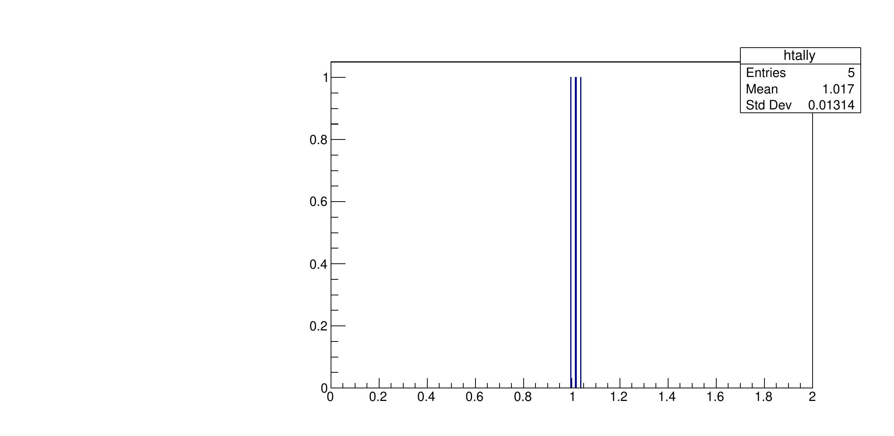
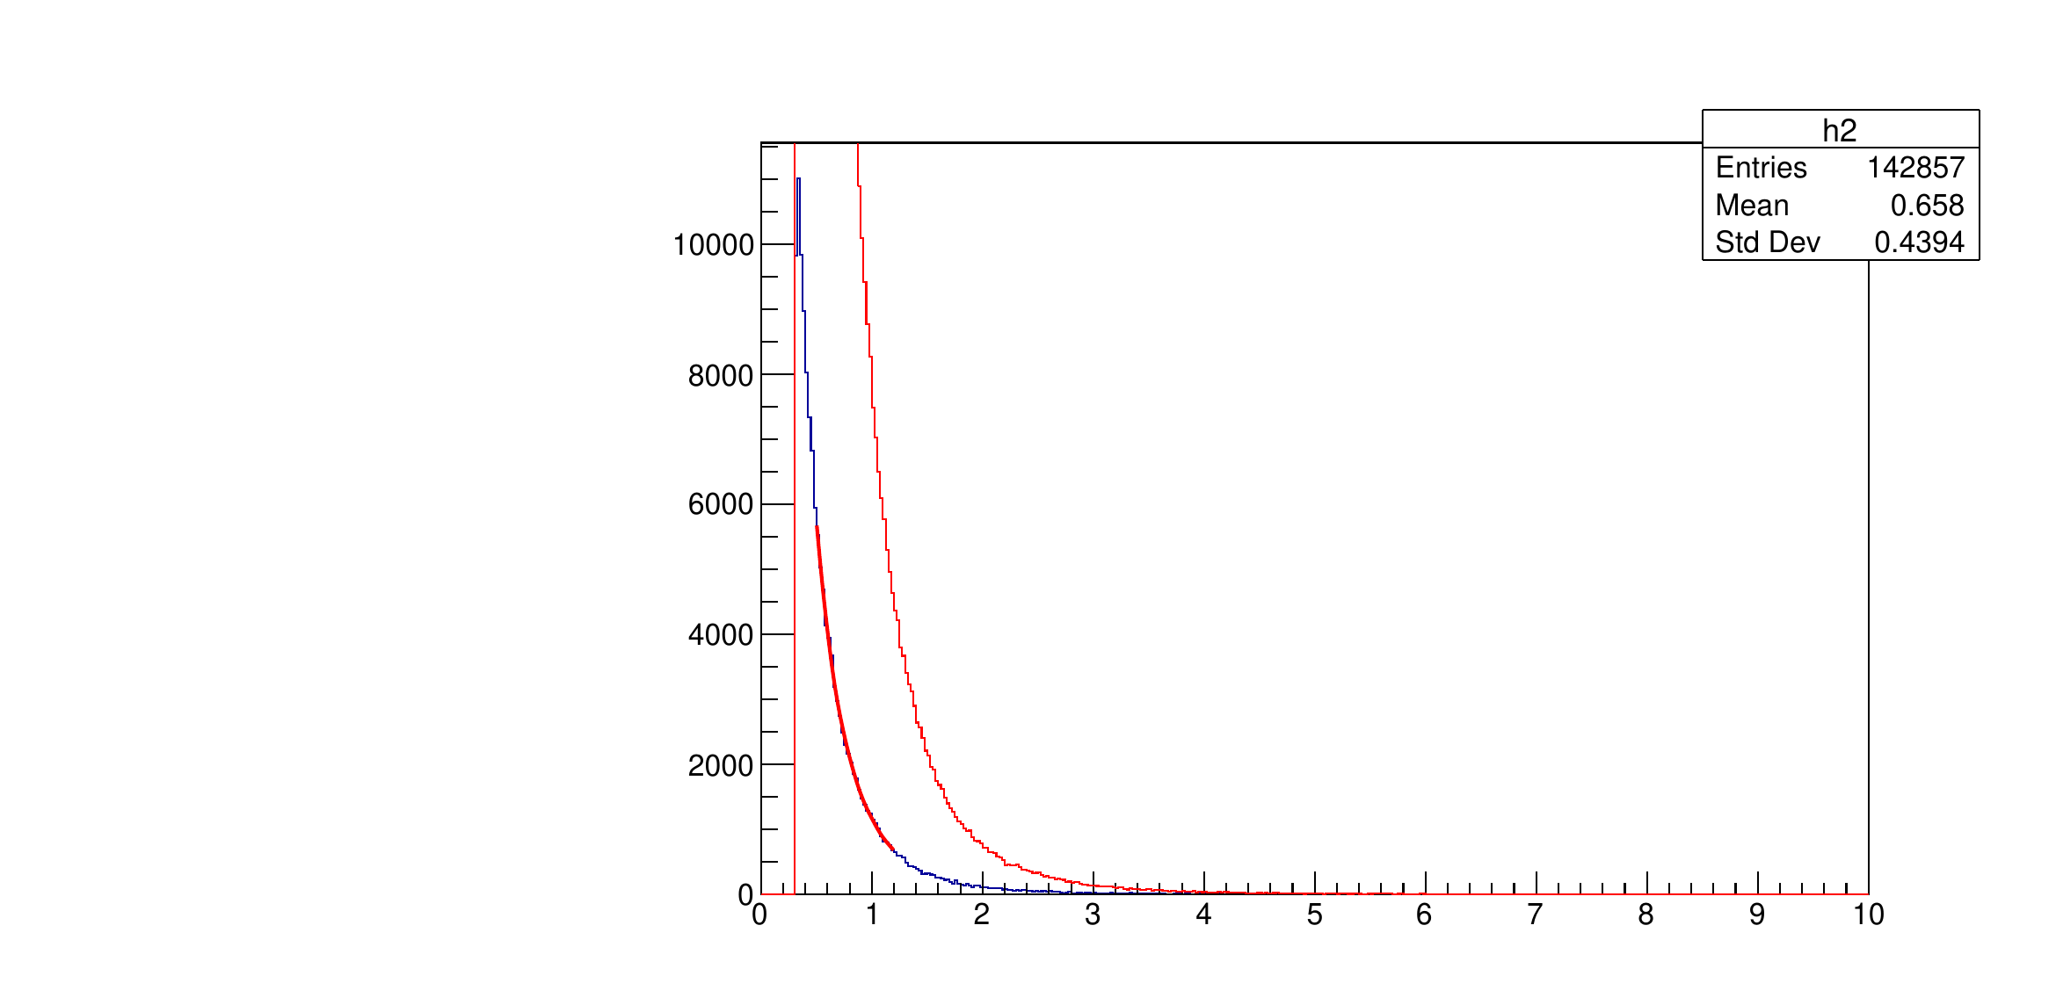

T = 1; m = 1.5 % shift
$σ=0.01314$
$\frac{σ}{\sqrt{N}}$ = 0.00588
$μ=1.017$

Slide 4
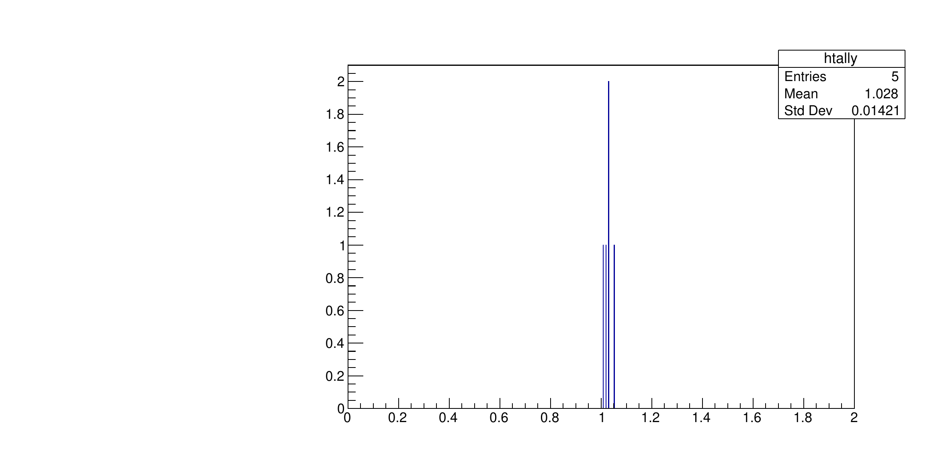
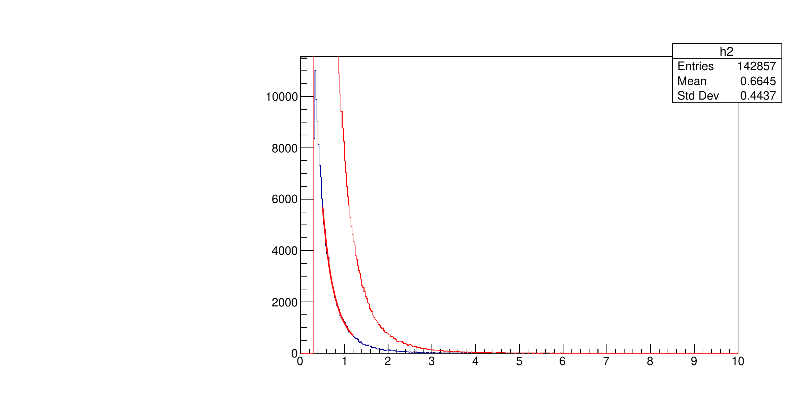

T = 2; m = 2.5 % shift
$σ=0.01421$
$\frac{σ}{\sqrt{N}}$ = 0.00635
$μ=1.028$

Slide 5
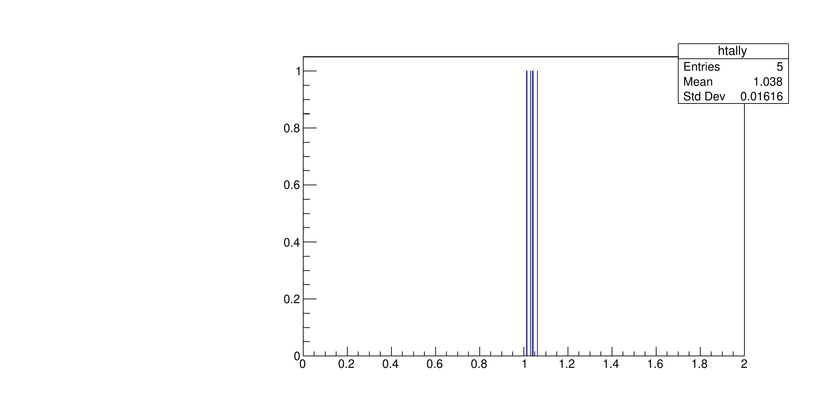


T = 3; m = 3.5 % shift
$σ=0.01616$
$\frac{σ}{\sqrt{N}}$ = 0.007227
$μ=1.038$

Slide 6



T = 4; m = 4.5 % shift
$σ=0.01358$
$\frac{σ}{\sqrt{N}}$ = 0.00607
$μ=1.045$

Slide 7
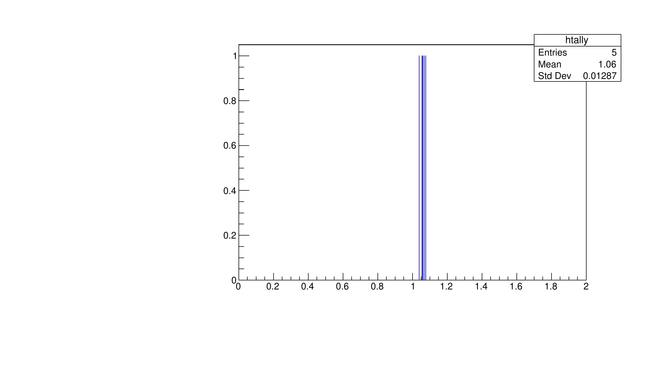
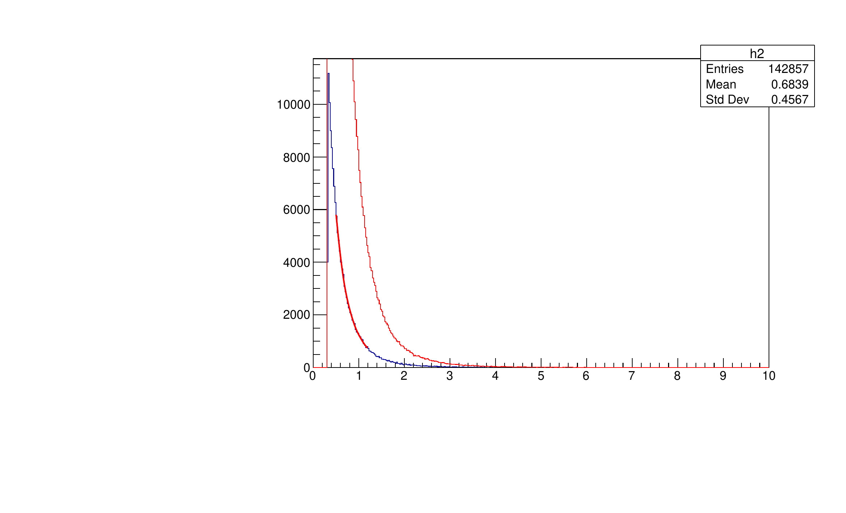

T = 5; m = 5.5 % shift
$σ=0.01287$
$\frac{σ}{\sqrt{N}}$ = 0.005756
$μ=1.06$

Slide 8
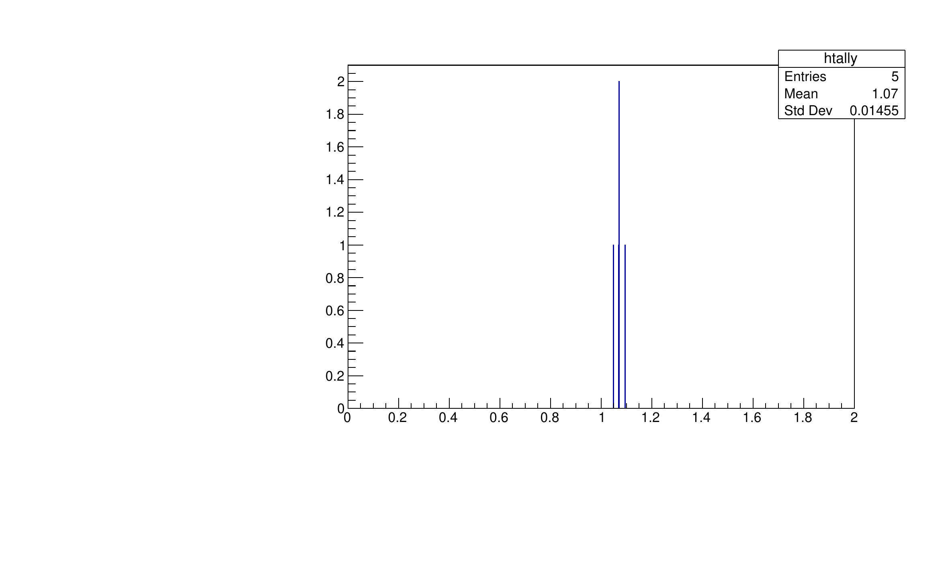


T = 6; m = 6.5 % shift
$σ=0.01455$
$\frac{σ}{\sqrt{N}}$ = 0.006507
$μ=1.07$

Slide 9
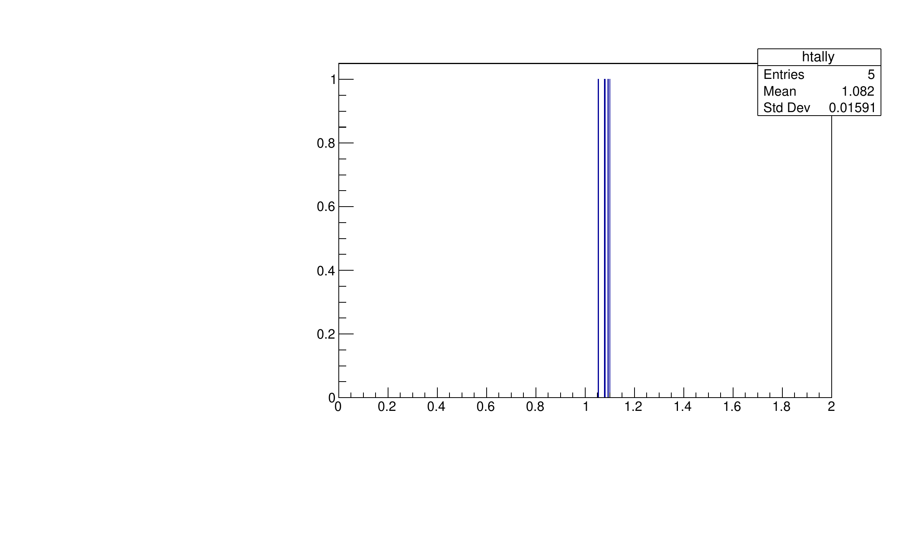


T = 7; m = 7.5 % shift
$σ=0.01591$
$\frac{σ}{\sqrt{N}}$ = 0.007115
$μ=1.082$

Slide 10



T = 8; m = 8.5 % shift
$σ=0.01694$
$\frac{σ}{\sqrt{N}}$ = 0.007576
$μ=1.09$

Slide 11
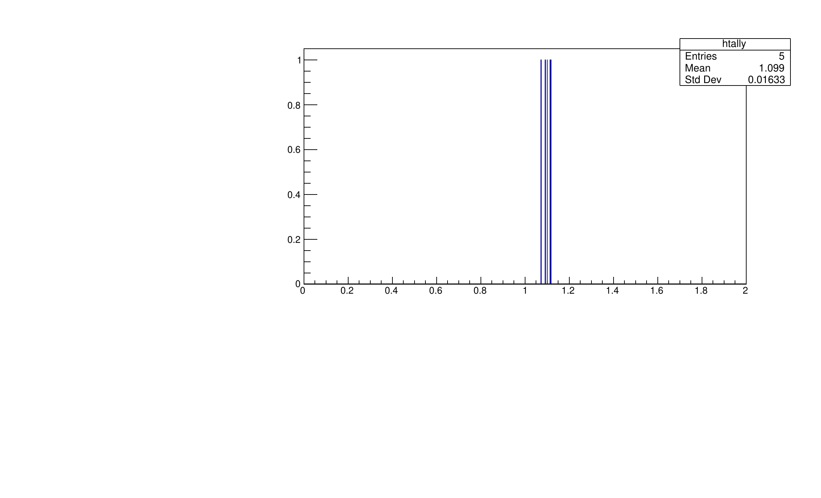


T = 9; m = 9.5 % shift
$σ=0.01633$
$\frac{σ}{\sqrt{N}}$ = 0.007303
$μ=1.099$

Slide 12
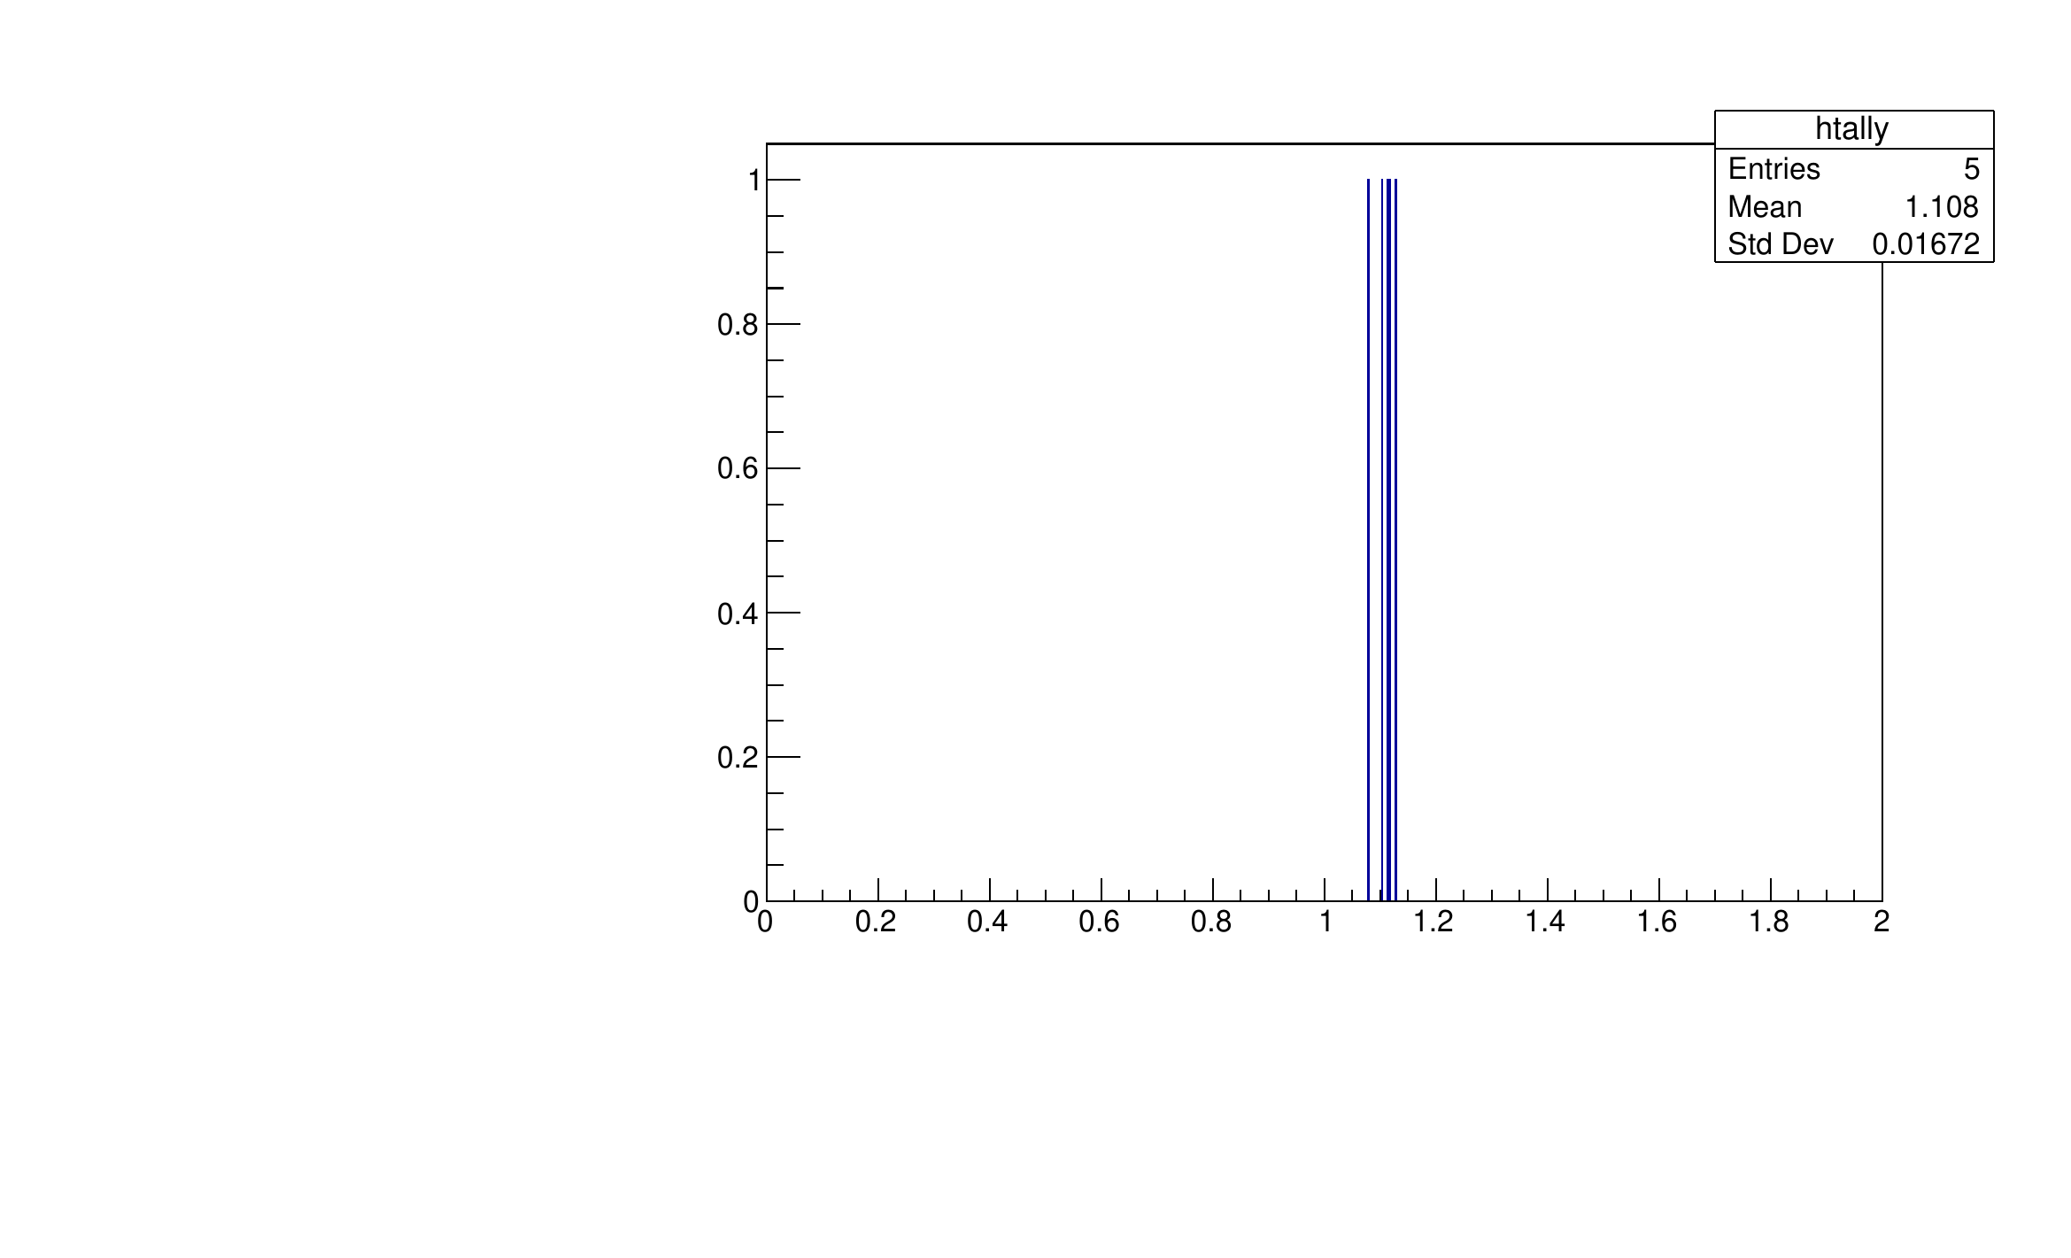


T = 10; m = 10.5 % shift
$σ=0.01672$
$\frac{σ}{\sqrt{N}}$ = 0.0074774
$μ=1.108$

Slide 13



T = 11; m = 11.5 % shift
$σ=0.01822$
$\frac{σ}{\sqrt{N}}$ = 0.00814923
$μ=1.117$

Slide 14



T = 12; m = 12.5 % shift
$σ=0.01703$
$\frac{σ}{\sqrt{N}}$ = 0.007616
$μ=1.119$

Slide 15
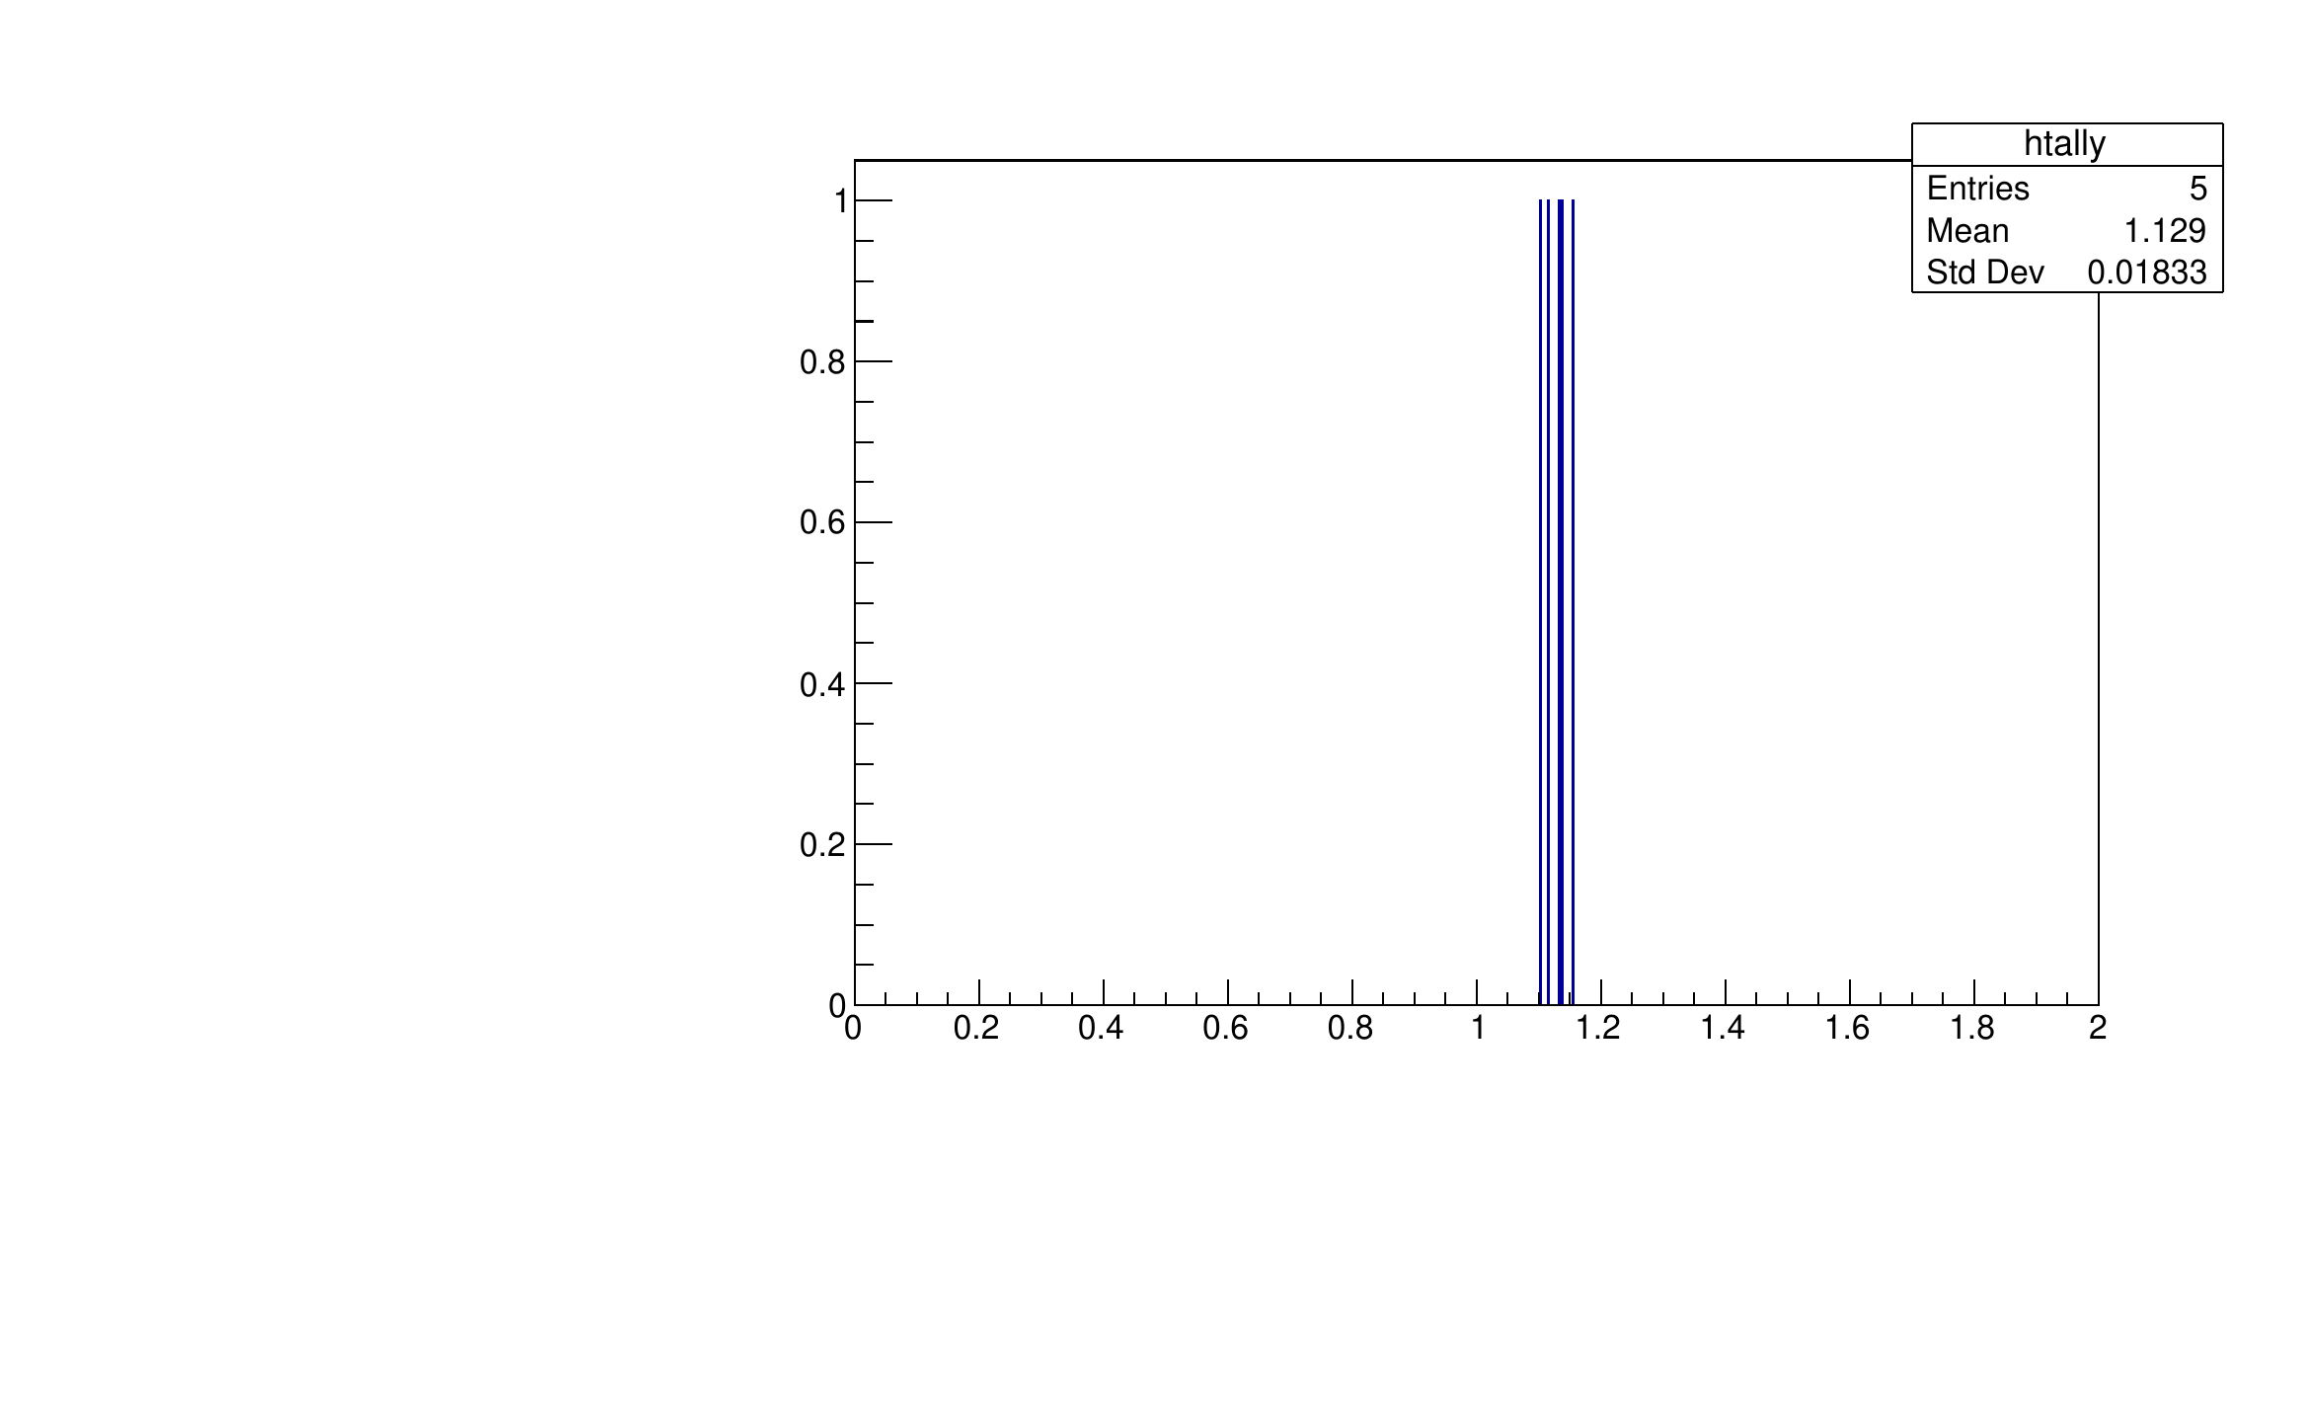
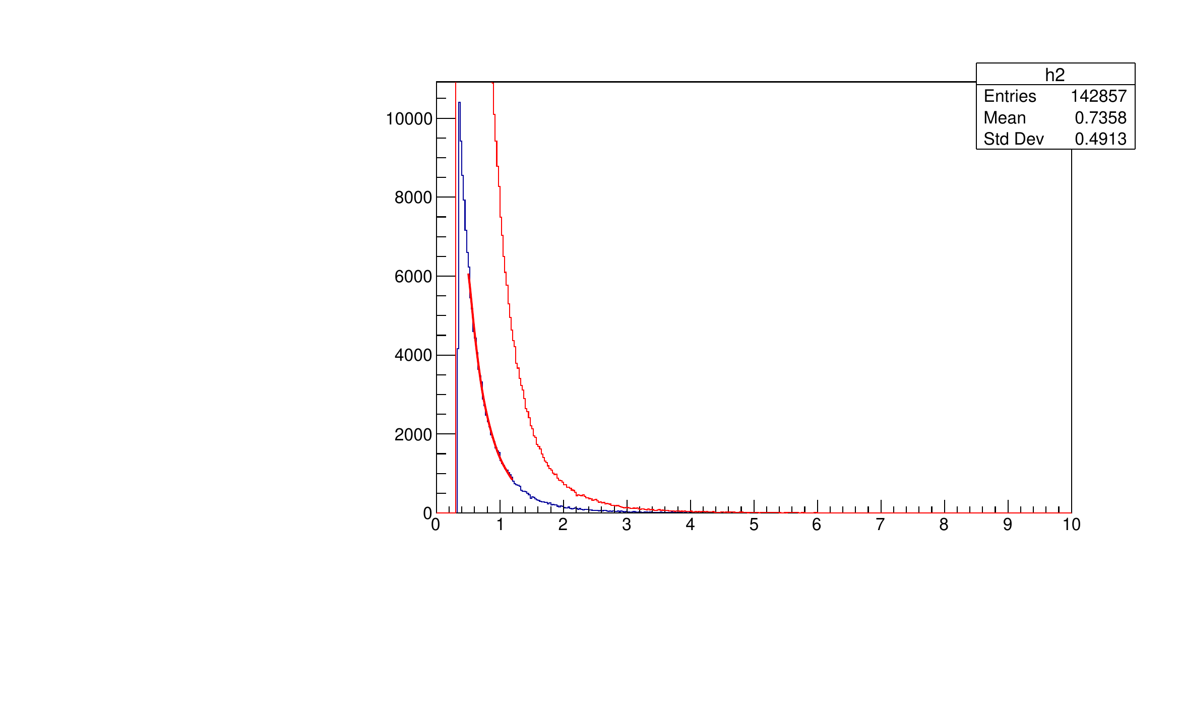

T = 13; m = 13.5 % shift
$σ=0.01833$
$\frac{σ}{\sqrt{N}}$ = 0.0081974
$μ=1.129$

Slide 16



T = 14; m = 14.5 % shift
$σ=0.01556$
$\frac{σ}{\sqrt{N}}$ = 0.00696
$μ=1.135$

Slide 17
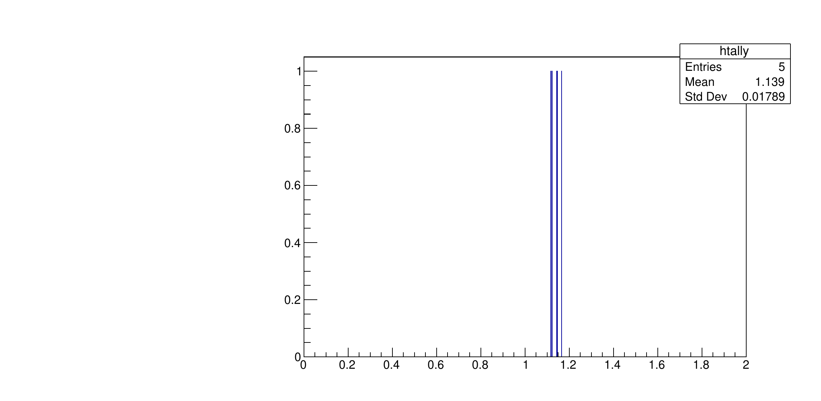
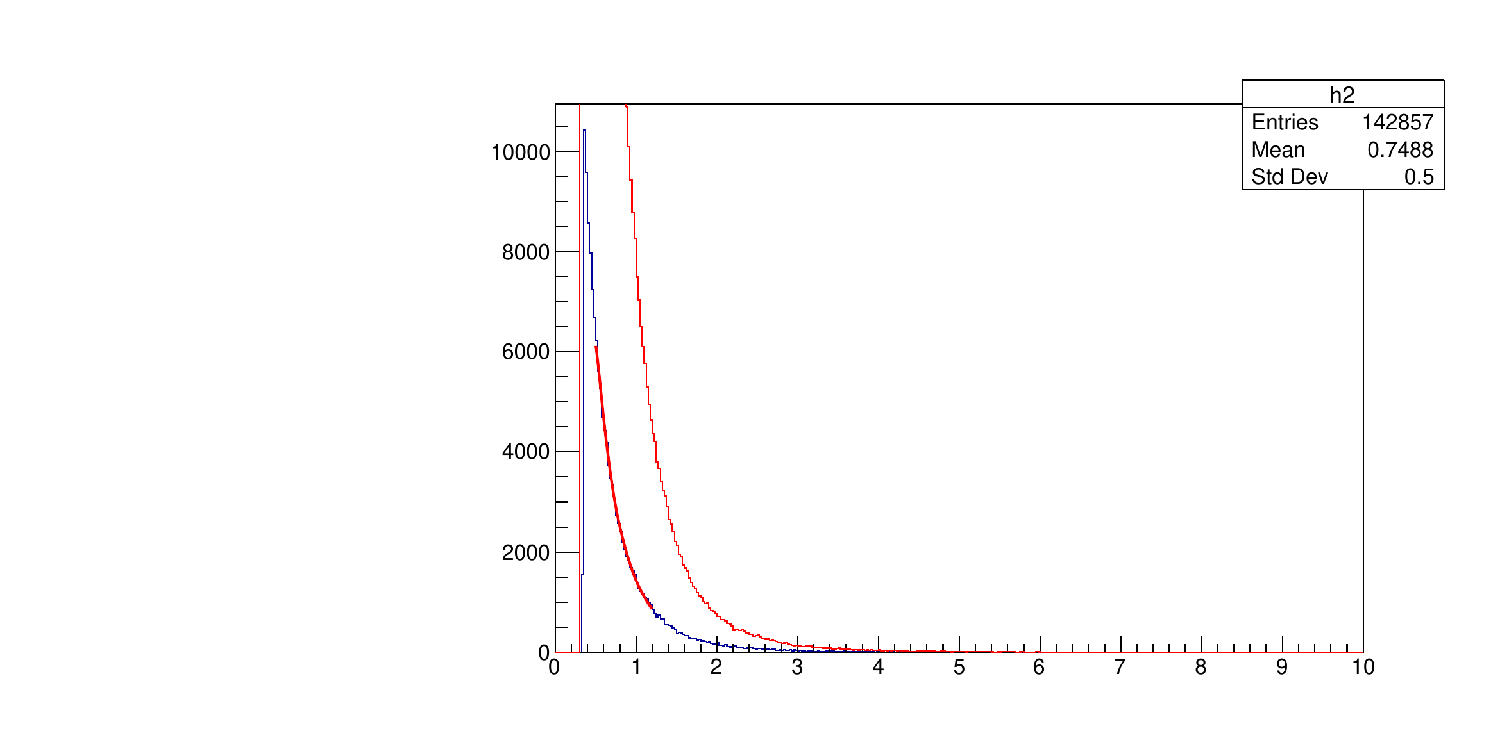

T = 15; m = 15.5 % shift
$σ=0.01789$
$\frac{σ}{\sqrt{N}}$ = 0.008
$μ=1.139$

